Slide 1


MAGIC CODE INSTITUTE
PYTHON
Lecture 4:
Data Manipulation & Visualization with Pandas

Slide 2
MAGIC CODE INSTITUTE
Section 4.1
Data wrangling, combine & reshape

Slide 3
MAGIC CODE INSTITUTE
Section 4.1
Data wrangling, combine & reshape
4.1.1: Hierarchical Indexing

Slide 4

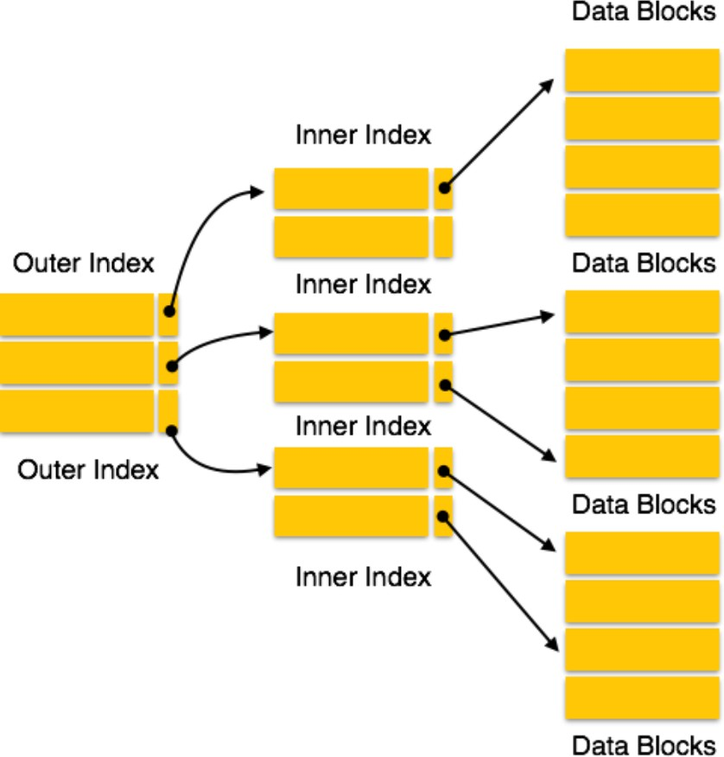

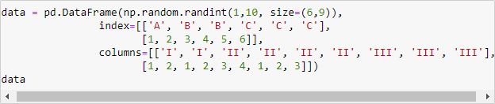
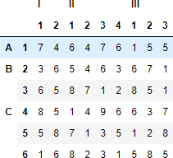
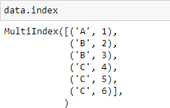
>> 4.1.1: Hierarchical Indexing
Multiple Index levels on one axis
A “MultiIndex” object as index
The “gap” means “use the same label above” (like in Excel)

Slide 5





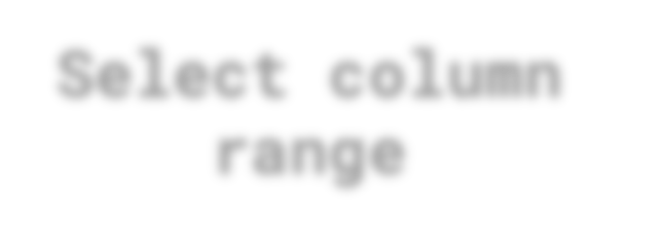
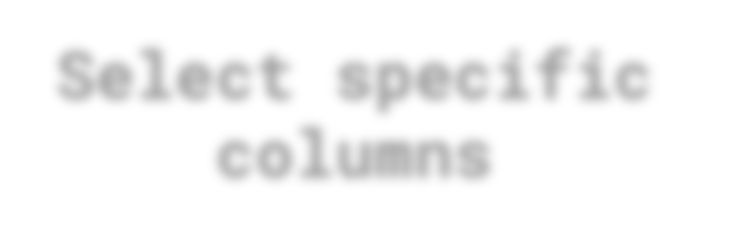

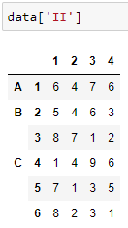
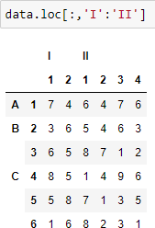
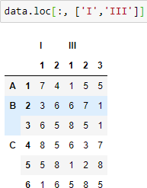
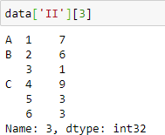
>> 4.1.1: Hierarchical Indexing - Partial Indexing
Horizontal Selection
Select column
Select column range
Select specific columns
Select column inner level

Slide 6





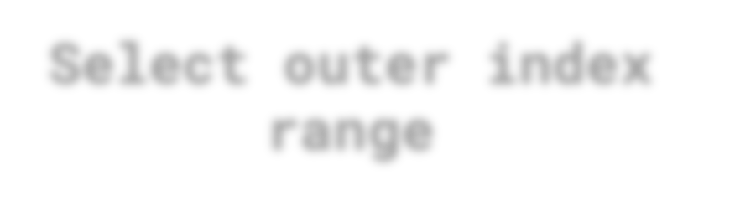
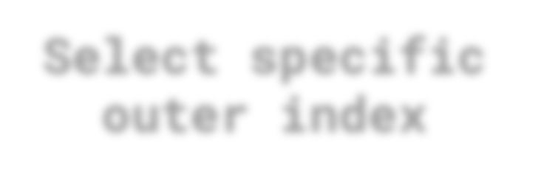

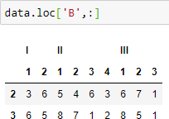
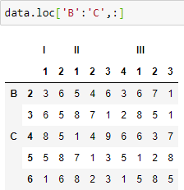
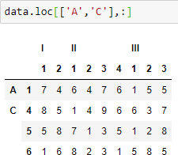
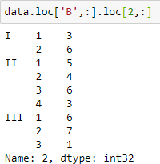
>> 4.1.1: Hierarchical Indexing - Partial Indexing
>> 4.1.1: Hierarchical Indexing - Partial Indexing
Vertical Selection
Select outer index
Select outer index range
Select specific outer index
Select inner index

Slide 7


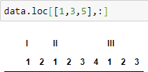
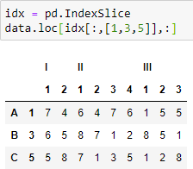


Level Selection
>> 4.1.1: Hierarchical Indexing - Partial Indexing
>> 4.1.1: Hierarchical Indexing - Partial Indexing
?
>> Select all data that has level 2 index equal to (1, 3 and 5)
!
>> Exercise: Select all data that has level 2 columns equal to 1

Slide 8




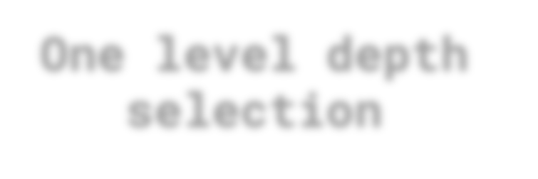
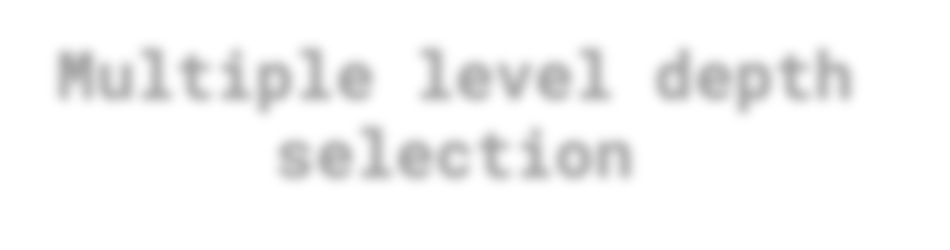
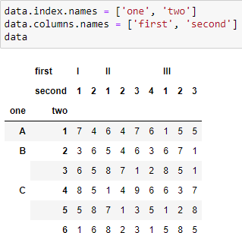
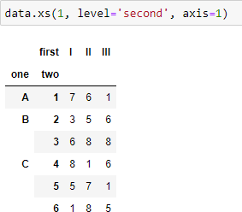
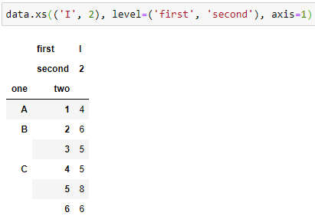
>> 4.1.1: Hierarchical Indexing
Cross-Section Selection
Assign index name
One level depth selection
Multiple level depth selection

Slide 9

MAGIC CODE INSTITUTE
Section 4.1
Data wrangling, combine & reshape
4.1.2: Combining and Merging

Slide 10
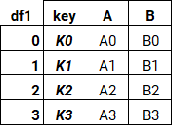
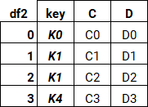
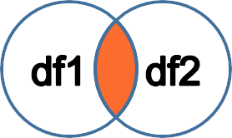
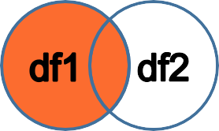
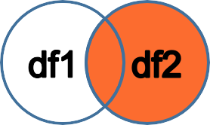
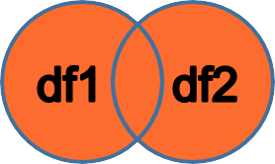
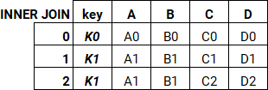
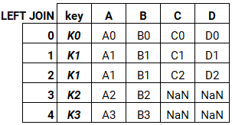
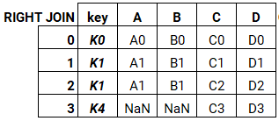
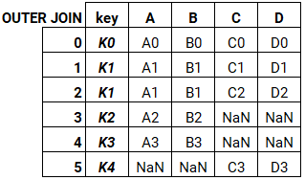
>> 4.1.2: Combining and Merging – Horizontal Joining
INNER JOIN
LEFT OUTER JOIN
RIGHT OUTER JOIN
FULL OUTER JOIN

Slide 11
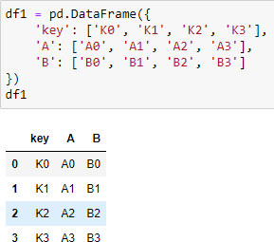
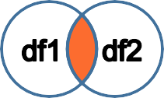

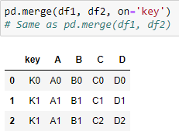
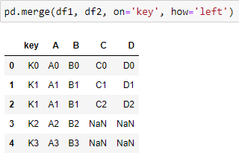
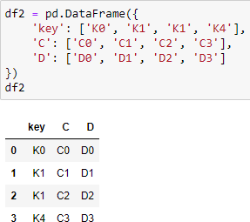
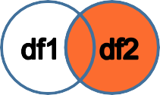
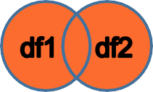
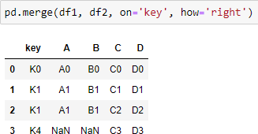
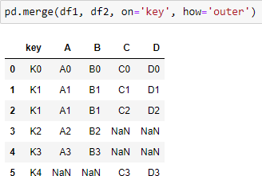
>> 4.1.2: Combining and Merging – Horizontal Joining
>> 4.1.2: Combining and Merging – Horizontal Joining
INNER JOIN
LEFT OUTER JOIN
RIGHT OUTER JOIN
FULL OUTER JOIN

Slide 12
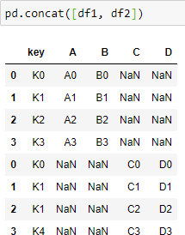
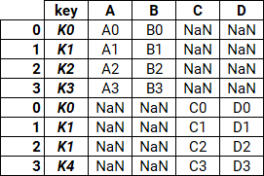
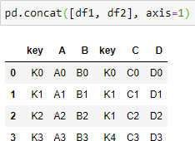
>> 4.1.2: Combining and Merging – Vertical Joining
Vertical joining DataFrame with pd.concat()
Can also Horizontal joining on index

Slide 13
MAGIC CODE INSTITUTE
Section 4.1
Data wrangling, combine & reshape
4.1.3: Reshaping Data

Slide 14
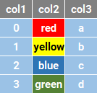


>> 4.1.3: Reshaping Data – What?
Row to column transformation
OR
Long data to Wide data

Slide 15
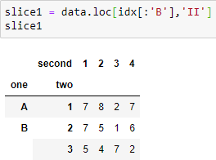
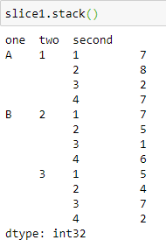
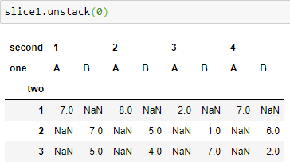
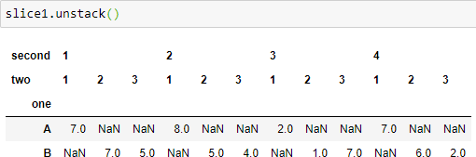
>> 4.1.3: Reshaping Data – How?
>> Column to Row transformation with stack() method
>> Reshaping with Hierarchical Indexing
>> By default the inner most index level got affected (unstack or stack)
>> You can unstack (or stack)
specific level by passing the level (numer or name) as argument
>> Row to Column transformation with unstack() method

Slide 16
MAGIC CODE INSTITUTE
Section 4.1
Data wrangling, combine & reshape
4.1.4: Pivoting

Slide 17




>> 4.1.3: Pivoting – Who needs Excel when you have Python
THE POWER OF PIVOTING

Slide 18

>> 4.1.3: Pivoting – Let’s get started
>> Load the ‘Macrodata’ dataset

Slide 19




>> 4.1.3: Pivoting
>> Take out a slice of the data the ‘cool’ way
>> Construct new time Index with ‘year’ and ‘quarter’

Slide 20



>> 4.1.3: Pivoting
>> Assign new index to new data
>> Let’s play around a little bit

Slide 21


>> 4.1.3: Pivoting
>> 4.1.3: Pivoting
>> Rename DataFrame columns
>> And pivot it back to before transformation
>> HASTA LA VISTA! WE WILL BE BACK!

Slide 22
MAGIC CODE INSTITUTE
Section 4.1
Plotting and Visualization with Matplotlib & Seaborn

Slide 23
MAGIC CODE INSTITUTE
Section 4.2
Data wrangling, combine & reshape
4.2.1: Matplotlib Primer

Slide 24



>> 4.2.1: Matplotlib Primer
>> Today our new magic words is
>> The correct way is to create a figure with plt.figure()
>> Adding subplots is EZPZ
>> And our first plot

Slide 25

>> 4.2.1: Matplotlib Primer
>> And even more subplots. No problemo!

Slide 26


>> 4.2.1: Matplotlib Primer
>> 4.2.1: Matplotlib Primer
>> Quicky create a grid of subplots. The axes object can be accessed like ndarray such as axes[0,1]
>> Access the grid of subplots and fill them with data

Slide 27


>> 4.2.1: Matplotlib Primer
>> 4.2.1: Matplotlib Primer
>> How about ploting multiple data on the same subplot?

Slide 28

>> 4.2.1: Matplotlib Primer
>> 4.2.1: Matplotlib Primer
>> Let’s put a name on everything. Do we? Set label and title of the plot

Slide 29

>> 4.2.1: Matplotlib Primer
>> 4.2.1: Matplotlib Primer
>> Set and display legend for each dataset

Slide 30

>> 4.2.1: Matplotlib Primer
>> 4.2.1: Matplotlib Primer
>> MATPLOTLIB GALLERY
https://matplotlib.org/gallery/index.html
Check it out

Slide 31

>> 4.2.1: Matplotlib Primer
>> 4.2.1: Matplotlib Primer
>> MATPLOTLIB GALLERY
https://matplotlib.org/gallery/index.html
Check it out

Slide 32
MAGIC CODE INSTITUTE
Section 4.2
Data wrangling, combine & reshape
4.2.2: Plotting with Pandas and Seaborn

Slide 33

>> 4.2.2: Plotting with Pandas and Seaborn
>> Pandas also has Matplotlib API integrated to plot data

Slide 34

>> 4.2.2: Plotting with Pandas and Seaborn
>> 4.2.2: Plotting with Pandas and Seaborn
>> The example that simulate 3 scenarios of stock price and then plot them, we can do it with pandas and in a much faster way. You’re quite welcomed!

Slide 35

>> 4.2.2: Plotting with Pandas and Seaborn
>> 4.2.2: Plotting with Pandas and Seaborn
>> Pandas can also do bar plot: vertical and horizontal

Slide 36

>> 4.2.2: Plotting with Pandas and Seaborn
>> 4.2.2: Plotting with Pandas and Seaborn
>> And of course multiple bar plot and even more…

Slide 37


>> 4.2.2: Plotting with Pandas and Seaborn
>> 4.2.2: Plotting with Pandas and Seaborn
>> The seaborn package is built upon the matplotlib package and offer more sophisticated ways to present data. Let’s explore!
>> Import the dataset
>> Bar plot with seaborn. Notice the error line?

Slide 38

>> 4.2.2: Plotting with Pandas and Seaborn
>> 4.2.2: Plotting with Pandas and Seaborn
>> Seaborn also did its own calculation under the hood and present data beautifully.
>> More than just histogram this is a >> Seaborn regression scatter plot distribution plot

Slide 39

>> 4.2.2: Plotting with Pandas and Seaborn
>> 4.2.2: Plotting with Pandas and Seaborn
>> Seaborn pairplot will do pair-wise analysis and plotting for all columns of the dataset

Slide 40





MAGIC CODE INSTITUTE
>> | PRINT(“THAT’S | FOR | TODAY, | FOLKS!!!”)
>> | EXIT()

